Slide 1
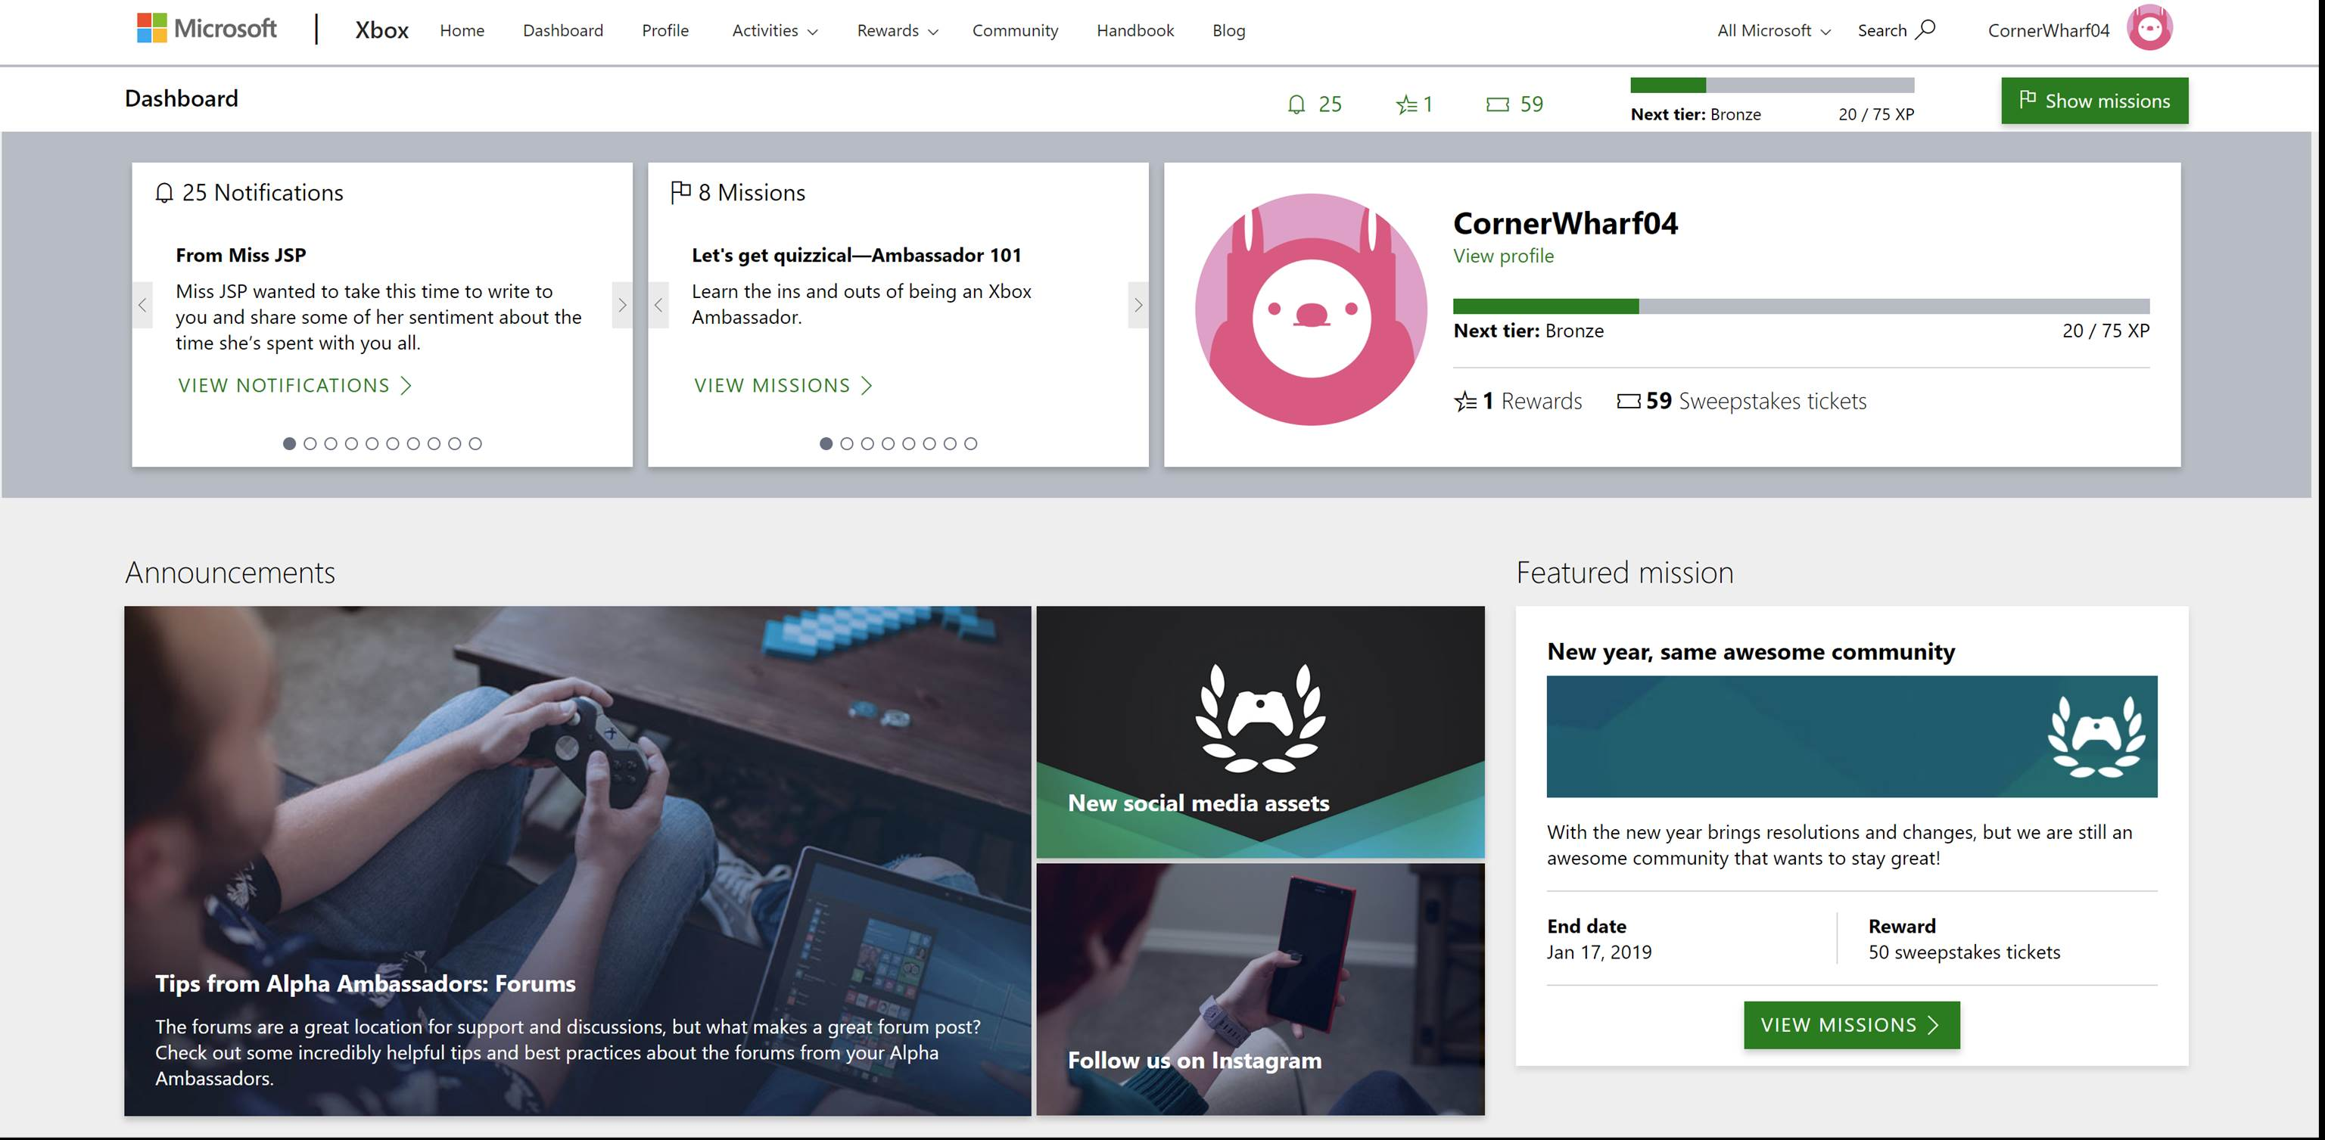
Xbox Ambassadors
Goal
The Xbox Ambassadors are a community of gamers working together to help the broader gaming community base resolve issues and answer questions. They came to Affirma initially to set up a team that would reduce call center costs. At the time, a significant amount service requests were going directly to the Microsoft call center.
Deliverables
Put together a development team dedicated to XA, along with content/social media manager, and community managers.
Built and maintains the Xbox Ambassador web application and Azure Service Fabric backend platform. We provide general .NET and Azure services to support all platform processes and activities
Created a dashboard for the Xbox Ambassadors with leaderboard KPIs.
Help run seasonal badge driven contests per quarter to drive Ambassador participation and service levels
Result
Reduction in call center cost through online gaming community
Helped establish a vibrant and active community of enthusiastic Xbox Ambassadors
Enriched online self-help services to solve issues online, in forums and on social media platforms

Slide 2
Xbox Ambassadors XA
Goal
The Xbox Ambassadors are a community of gamers working together to help the broader gaming community base resolve issues and answer questions. They came to Affirma initially to set up a team that would reduce call center costs. At the time, a significant amount service requests were going directly to the Microsoft call center.
Deliverables
Put together a development team dedicated to XA, along with content/social media manager, and community managers.
Built and maintains the Xbox Ambassador web application and Azure Service Fabric backend platform. We provide general .NET and Azure services to support all platform processes and activities
Created a dashboard for the Xbox Ambassadors with leaderboard KPIs.
Help run seasonal badge driven contests per quarter to drive Ambassador participation and service levels
Result
Reduction in call center cost through online gaming community
Helped establish a vibrant and active community of enthusiastic Xbox Ambassadors
Enriched online self-help services to solve issues online, in forums and on social media platforms
Support and content overall are much improved from when Affirma first engaged with the XCS team

